Slide 1
JW Aluminum Modern Day Slavery Statement 2024
December 6, 2024

Slide 2
Introduction
JW Aluminum’s position on Modern Slavery aligns closely with our cultural values and establishes a framework for expected behaviors among all team members and partners, regardless of their level. It outlines how we embody our WIN culture, perform our business activities, and engage with one another, our partners, and the environment, with a particular focus on social, environmental, and governance principles.
Through rigorous assessments and continuous improvement, we strive to ensure that our practices not only comply with legal standards but also reflect our core values of respect and integrity for all individuals involved in our business.
In our second annual Modern Slavery Statement, we reaffirm our commitment to combating modern slavery as an integral part of our ongoing efforts to enhance human rights within both our internal operations and our supply chain. We recognize the importance of transparency, accountability, and proactive measures in addressing this critical issue.

Slide 3
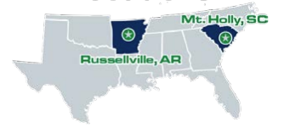
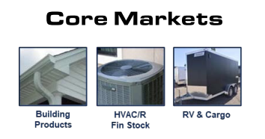
Company Profile
JW Aluminum, established in 1979 and headquartered in Charleston, South Carolina, is a privately owned company specializing in the production of flat rolled aluminum products.
With a steadfast commitment to safety and ethics, approximately 500 dedicated teammates work to ensure a sustainable future for all stakeholders associated with the business.
As a significant player in American manufacturing for over four decades, JW Aluminum focuses on producing infinitely recyclable aluminum sheets and foils. These products are integral to various applications, including essential building products and HVAC components that contribute to the comfort and safety of homes.
Our operations are exclusively within the United States, reinforcing our commitment to supporting the local economy and adhering to U.S. manufacturing standards.
Plant Locations
300+ Million Pounds Shipped Annually

Slide 4
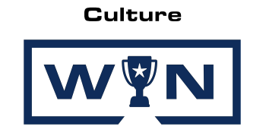
Company Culture
At JW Aluminum, our WIN culture serves as the foundation of our operations and interactions. WIN stands for **Work, Innovate, and Nurture**, encapsulating our commitment to excellence in every aspect of our business.
Work: We believe in the power of teamwork and diligence. Each member of our team is encouraged to take initiative, collaborate effectively, and contribute to the shared goals of the organization. Our teammates take ownership of their roles, ensuring that we collectively deliver high-quality products and services.
Innovate: We are dedicated to continuous improvement and creativity in our processes. By fostering an environment where new ideas are welcomed and explored, we drive innovation that enhances our operations and meets the evolving needs of our customers. Our focus on innovation allows us to stay competitive in the aluminum industry and ensures we are always looking for better solutions.
Nurture: We prioritize a supportive and respectful workplace culture that values diversity and inclusion. By nurturing our workforce, we empower individuals to grow both personally and professionally. This commitment to fostering talent and skills development not only helps our team members thrive but also strengthens our organization.
The WIN culture is not just a statement; it is a guiding principle that influences our decision-making, strategic planning, and day-to-day operations. It reflects our dedication to conducting business with integrity and accountability, maintaining high standards, and consistently seeking ways to develop our people and improve our processes. By embodying these values, we aim to create a positive impact on our teammates, customers, and the communities we serve, ensuring long-term success and sustainability for JW Aluminum.

Slide 5
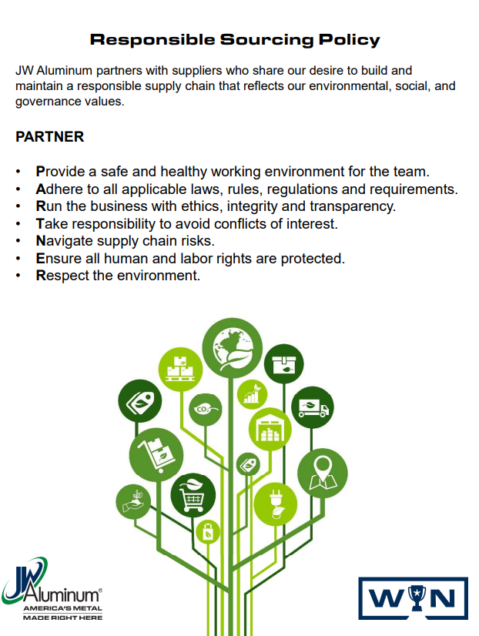
Our Supply Chain
JW Aluminum takes pride in its long-standing partnerships with our suppliers. Most of our products and services are obtained from domestic sources, with the remainder imported from Canada, Europe, Mexico, and Australia.
We procure products and services essential for our manufacturing processes and operational support. For manufacturing, our sourced products include primary aluminum and scrap aluminum, such as painted siding, MLC, foil, UBC, fin stock, EC wire, and extrusions. The services we utilize for manufacturing may involve contractors, consulting services, utilities, and more.
Our centralized procurement team oversees the acquisition of the bulk of our products and services.
To support our operations, we source products like IT equipment, manufacturing machinery, and distribution network essentials, among other items. Additionally, the services we require to support operations encompass cleaning services, security, consulting services, and various corporate and operational needs.

Slide 6
Governance & Framework
JW Aluminum has a formal governance structure with senior leadership oversight, auditing mechanisms and programs including the review and reporting of Modern Slavery.
JW Aluminum’s Governance structure and its statements are supported by a policy set. The policies outlined below are those most relevant to managing Modern Slavery risks.
Policy | Purpose
JW Governance Policy | JW Aluminum uses this governance policy to drive ethical, accountable, and transparent business practices. It outlines the principles, policies, and approach we take to manage risk and operate responsibly
Code of Conduct | The Code of Conduct and Ethics (the “Code of Conduct” or the “Code”) sets forth the expectations of how we live WIN, conduct business, and interact with each other and our business partners. We are a business of business people committed to a culture of teamwork and continuous improvement to Secure the Future for teammates and customers.
Equal Employment Opportunity and commitment to diversity. | JW Aluminum recognizes the importance of equal opportunity and diversity in the workplace and values the contribution of all teammates regardless of gender, age, ethnicity, disability, sexual orientation, cultural background, and other immutable characteristics. These policies aim to ensure that the work environment is free from discrimination, harassment and bullying and that everyone respects and value the diversity of our workplace.
Human Rights Policy | JW Aluminum is committed to abiding by international human rights principles encompassed in the Universal Declaration of Human Rights, the International Labor Organization’s Declaration on Fundamental Principles and Rights at Work, the United Nations Global Compact and the United Nations Guiding Principles on Business and Human Rights.
Child Labor Policy | As an organization, we want to do business in a legal, ethical manner adding value to society and the environment instead of doing harm. Helping stop child labor is fundamental to us. We want to make sure that our organization doesn’t take part in children’s exploitation and helps end it to the best of our ability.
Human Trafficking Policy | JW Aluminum strictly prohibits teammates, subcontractors, subcontractor teammates, and agents from engaging in human trafficking-related activities. These activities include engaging in sex trafficking, procuring commercial sex acts using force, fraud, or coercion to subject a person to involuntary servitude, or obtaining labor from a person by threats of serious harm to that person or another person, among others.
Responsible Sourcing Policy | JW Aluminum partners with suppliers who share our desire to build and maintain a responsible supply chain that reflects our environmental, social, and governance values.
Supplier Conduct Policy | Our JW Vision requires that we work only with Suppliers who can consistently meet our standards and specifications and are committed to values of conduct that are compatible with our own. This commitment is reflected in our Supplier Conduct Policy that sets out the minimum standards of behavior we require of our Suppliers
Supplier Trading Agreement | The content of the Supplier Conduct Policy is included in our Purchase Order Terms and Conditions. Acceptance of our purchase order constitutes acceptance of the Supplier Conduct Policy.

Slide 7
Risk Assessment
JW Aluminum is committed to assessing significant suppliers based on business impact and geographical location.
JW Aluminum’s risk assessment of suppliers considers the following:
Location
Some countries and regions have increased risk of Modern Slavery. JW Aluminum classified country risk based on the 2022 Global Slavery Index’s Vulnerability profile..
Outsourcing
JW Aluminum purchases some of its raw materials from bulk suppliers and may have limited visibility into their procurement of the raw materials. JW Aluminum will consider the products from these suppliers on a future risk assessment.
Audits
Suppliers are given a regular supplier questionnaire that is targeted at gathering additional information to determine the level of human rights and modern slavery risk associated with that supplier.
Trade Agreements
JW Aluminum has updated its Terms and Conditions of Purchase and some specific trade agreements to include our Supplier Conduct Policy which contains a Modern Slavery clause. When a supplier accepts our Purchase Order or signs such specific trade agreements, JW Aluminum considers such supplier to have a lower risk.
Industry
Suppliers in industries dependent on low-cost labor are considered higher risk.
Financial Impact
Suppliers are ranked by how important they are to our business and if we can (insignificant impact) or cannot (critical impact) operate without their product.
Reputation Impact
Suppliers are ranked according to if they can affect our reputation even if their practices have nothing to do with us.

Slide 8
Risk Assessment
Risk | Description | Finding | Our Risk Exposure
1 | Contract workers directly engaged | JW’s workforce is 100% permanent. | LOW
2 | Workers under the age of 18 | JW does not hire workforce under the age of 18. | LOW
3 | Migrant Workers | JW does not have any teammate under a temporary worker status. | LOW
4 | Seasonal Workforce | JW operations are not seasonal and is not considered in hiring practices. Turnover is consistent during the reporting period. | LOW
5 | Freedom of Association | JW respects freedom of association although none of our locations operate under bargaining agreements. | LOW
6 | External Auditing | All JW facilities are certified to ISO9001 Quality Standard and ASI Performance Standard V3 | LOW
7 | Operational Sector Risk | JW does not operate in any high-risk sectors | LOW
8 | Services directly engaged | JW relies on services including recruitment, legal, cleaning services, property maintenance, waste disposal and equipment maintenance. Recruitment, construction and cleaning services are considered particularly high risk, but none of these are sourced outside the United States, thus lowering the risk. | LOW
9 | Grievance Mechanism | JW Aluminum has a grievance mechanism in place and has had zero complaints made regarding human trafficking or modern slavery | LOW
10 | Disclosure of Instances | JW Aluminum has not identified any instances of modern slavery or sourcing from CAHRA’s within its organization or supply chain | LOW

Slide 9
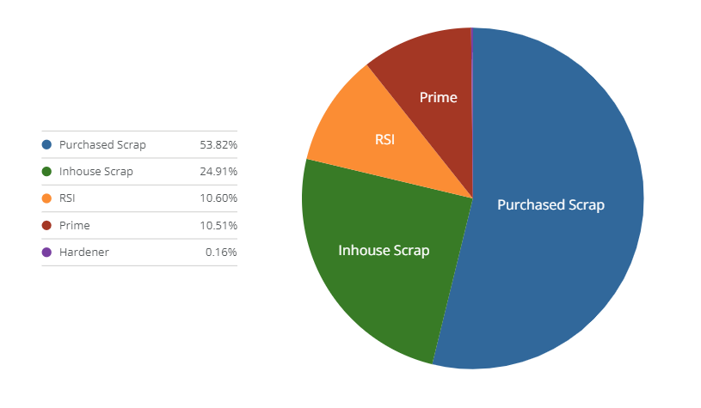
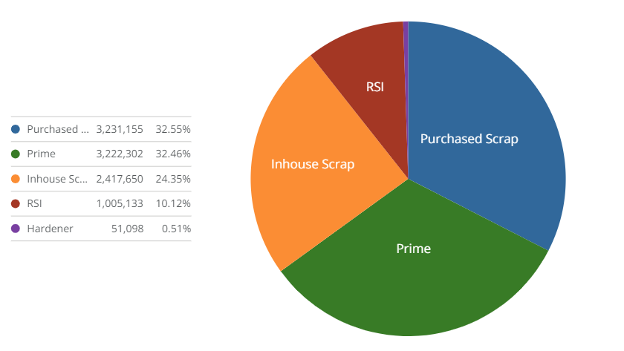
Risk Assessment
During the reporting period Q1 2022 – Q2 2023, JWAluminum focused on the largest suppliers in raw material purchases and any suppliers with operations outside of the United States regardless of procurement segment.
JWAluminum’s largest procurement segment feeding is manufacturing business is the purchase of raw materials namely scrap aluminum., US suppliers account for 97% of the raw material purchased and 76% of total procurement. YTD, primary aluminum accounts for 10.51% and 32.46% of raw material usage for MTH and RSV facilities, respectively.
MTH Raw Material Consumption
RSV Raw Material Consumption
*Data collected is Q1 2022 – Q2 2023. JW purchase and supplier sources are consistent from year to year.
Thus, an update of purchasing values and supplier data will be provided every two years, with the next refresh of this information in 2025.

Slide 10
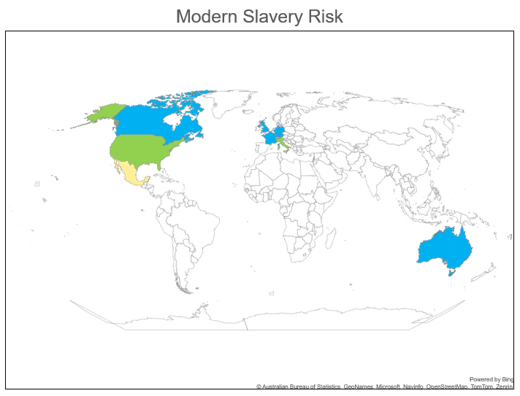
Risk Assessment
Suppling Country | % of Total JW Aluminum $ purchased | # of Suppliers | Global Slavery Vulnerability Index
Australia | 0.0032% | 1 | 6.8
Canada | 0.5511% | 3 | 10.7
France | 0.0177% | 1 | 13.3
Germany | 0.0003% | 1 | 10.7
Italy | 0.0765% | 2 | 21.7
Mexico | 0.8512% | 2 | 58.1
Netherlands | 0.0357% | 2 | 6.0
Switzerland | 1.1515% | 1 | 13.6
United Kingdom | 0.3411% | 7 | 14.3
United States | 96.9716% | 708 | 24.5
Total | 100% | 728
Index Range | Risk Level
0-20 | Very Low
21-40 | Low
41-60 | Medium
61-80 | High
81-100 | Very High
*Data collected is Q1 2022 – Q2 2023. JW purchase and supplier sources are consistent from year to year.
Thus, an update of purchasing values and supplier data will be provided every two years, with the next refresh of this information in 2025.
The weighted average Vulnerability Index (weighted on $ purchased) is 24.5
JWAluminum’s overall supply chain risk is Low.

Slide 11
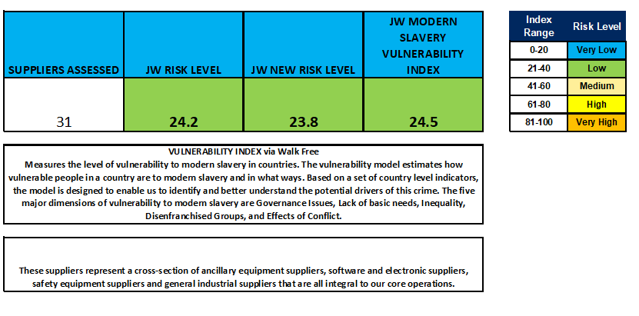
Actions and Effectiveness
From Q3 2023 to Q3 2024, JW Aluminum has assessed 31 suppliers.
  12 suppliers were found to be very low risk level
  17 were found to be low risk level
  2 were at medium risk level.
These scores resulted in a 24.2 risk level compared to a 24.5 vulnerability index for JW.
Corrective actions were issued for medium risk suppliers and upon closure resulted in a reduced risk level of 23.8.
Of those assessed, 2 were suppliers of primary aluminum.
Neither supplier showed evidence of sourcing from CAHRA’s.

Slide 12
Actions and Effectiveness
Risk Area | Description | Mitigation Strategy | Effectiveness
Supply Chain | Suppliers and subcontractors may engage in forced labor or exploitative practices. | Conduct thorough due diligence, including assessments of suppliers. Implement a Supplier Conduct policy. | Suppliers are alerted via email of our Supplier Conduct Policy and the need for assessments of their practices. The content of the Supplier Conduct Policy is included in our Purchase Order Terms and Conditions. Acceptance of our purchase order constitutes acceptance of the Supplier Conduct Policy. To date, 31 suppliers have received assessment questionnaires. 12 suppliers were found to be very low risk level, 17 were found to be low risk level, and 2 were at medium risk level. These scores resulted in a 24.2 risk level compared to a 24.5 vulnerability index for JW. Corrective actions were issued for medium risk suppliers and upon closure resulted in a reduced risk level of 23.8.
Raw Material Sourcing | Mining of raw materials (e.g., bauxite, aluminum) may involve child labor or other abuses. | Source materials from suppliers who adhere to responsible sourcing standards. | YTD, primary aluminum accounts for 10.51% and 32.46% of raw material usage for MTH and RSV facilities, respectively.
Supplier Relationships | Long-standing relationships may obscure issues related to supplier practices, including labor violations. | Conduct regular supplier assessments and encourage transparency in labor practices. Establish feedback mechanisms for suppliers to report issues. | JW selects annually the number of suppliers it will assess for the year. This is reviewed and updated quarterly by the Responsible Sourcing Team. Suppliers have direct line of contact with their procurement owner and have access our online reporting mechanism. JW has assessed it's 2 major suppliers of primary aluminum for modern slavery risk as well as sourcing from CAHRA’s.
Domestic vs. Imported Suppliers | Domestic suppliers may have higher compliance rates, but imported goods from regions with weaker regulations may pose risks. | Assess imported suppliers for compliance with labor standards. Implement a risk-based approach for monitoring international suppliers. | JW has established a risk-based approach to supplier assessments utilizing key indicators important to the business. Though minimal, current or new imported suppliers have priority in assessments.
Specific Product Sourcing | Sourcing primary aluminum and scrap materials may involve sectors known for labor exploitation (e.g., mining). | Ensure traceability of materials and demand certifications that guarantee ethical sourcing practices. Conduct due diligence on sourcing practices for key materials. | From Q3 2023 to Q3 2024, JW Aluminum has assessed 31 suppliers. Of those assessed, 2 were suppliers of primary aluminum. Neither supplier showed evidence of sourcing from CAHRA’s.
Service Providers | Contractors and consulting services may inadvertently utilize exploitative labor practices. | Include clauses in contracts that require compliance with labor rights. Vet service providers for their labor practices before engagement. | The content of the Supplier Conduct Policy is included in our Purchase Order Terms and Conditions. Acceptance of our purchase order constitutes acceptance of the Supplier Conduct Policy.
IT and Manufacturing Equipment | Suppliers of equipment may operate in regions with known labor abuses. | Verify labor practices when sourcing machinery and equipment. Engage with vendors who adhere to ethical labor standards. | The Procurement function follows the Principles of Sustainability and Social Responsibility of the Institute for Supply Management. JW has assessed the risk of 18 MRO suppliers YTD. All were found to have very low or low modern slavery risk.

Slide 13
Actions and Effectiveness
Risk Area | Description | Mitigation Strategy | Effectiveness
Cleaning and Security Services | Providers of cleaning and security services may employ vulnerable workers who are at risk of exploitation. | Implement a code of conduct for service providers and require training on modern slavery for all contractors and service providers. | JW has issued a Code of Conduct which has been communicated to service providers. They expectations are reviewed at servicer orientation and annually thereafter.
Labor Recruitment | Recruitment practices may exploit workers or involve trafficking in persons. | Partner with reputable recruitment agencies that comply with ethical hiring practices. Provide training on fair recruitment. | JW has tasked its HR department with partnering and monitoring the hiring process of and recruitment agencies that we partner with. These agencies are required to meet JW Aluminum’s standard of a recruiting process.
Temporary and Migrant Workers | These workers may be at higher risk of exploitation and lack awareness of their rights. | Offer training programs on workers' rights and provide access to support services for migrant workers. | JW Aluminum requires all teammates and contractors to complete an annual code of conduct training that review expectations on worker’s rights.
Internal Policies and Training | teammates may not be aware of modern slavery issues or the company's stance against it. | Implement training programs on modern slavery and ethical practices for all teammates. | Teammate are giving an annual code of conduct training that review the company’s stance on modern slavery. The policies are also available throughout our facilities for teammates to access.
Community and Local Engagement | Local communities may lack resources or protections against exploitation in labor practices. | Engage with community organizations to promote awareness and establish support systems for vulnerable groups | Facilities partner with their local Chamber of Commerce to identify ways to engage and support their community.

Slide 14

Conclusion
As we continue to build upon our previous initiatives, we have implemented several strategies to further identify and mitigate risks associated with modern slavery and sourcing from CAHRA’s. These include conducting risk assessments across our supply chain, engaging with suppliers to promote ethical labor practices, and providing training to our teammates on recognizing and responding to signs of modern slavery.
Our commitment extends beyond compliance; we are dedicated to fostering an environment where dignity and respect are paramount.
We encourage all stakeholders, including suppliers, teammates, and customers, to join us in this critical mission. By working together, we can make significant strides toward a future free from modern slavery and uphold the fundamental rights of every individual.
Moving into 2025, JW will:
Continue to monitor our progress, refine our strategies, and hold ourselves accountable to our commitments.
Assess 10 additional suppliers annually and improve response rate.
Work in partnership with suppliers to support improvement efforts if our assessment indicates a risk level above 40.
Collaborate with suppliers to further the understanding of our primary aluminum supply chain.

